Slide 1
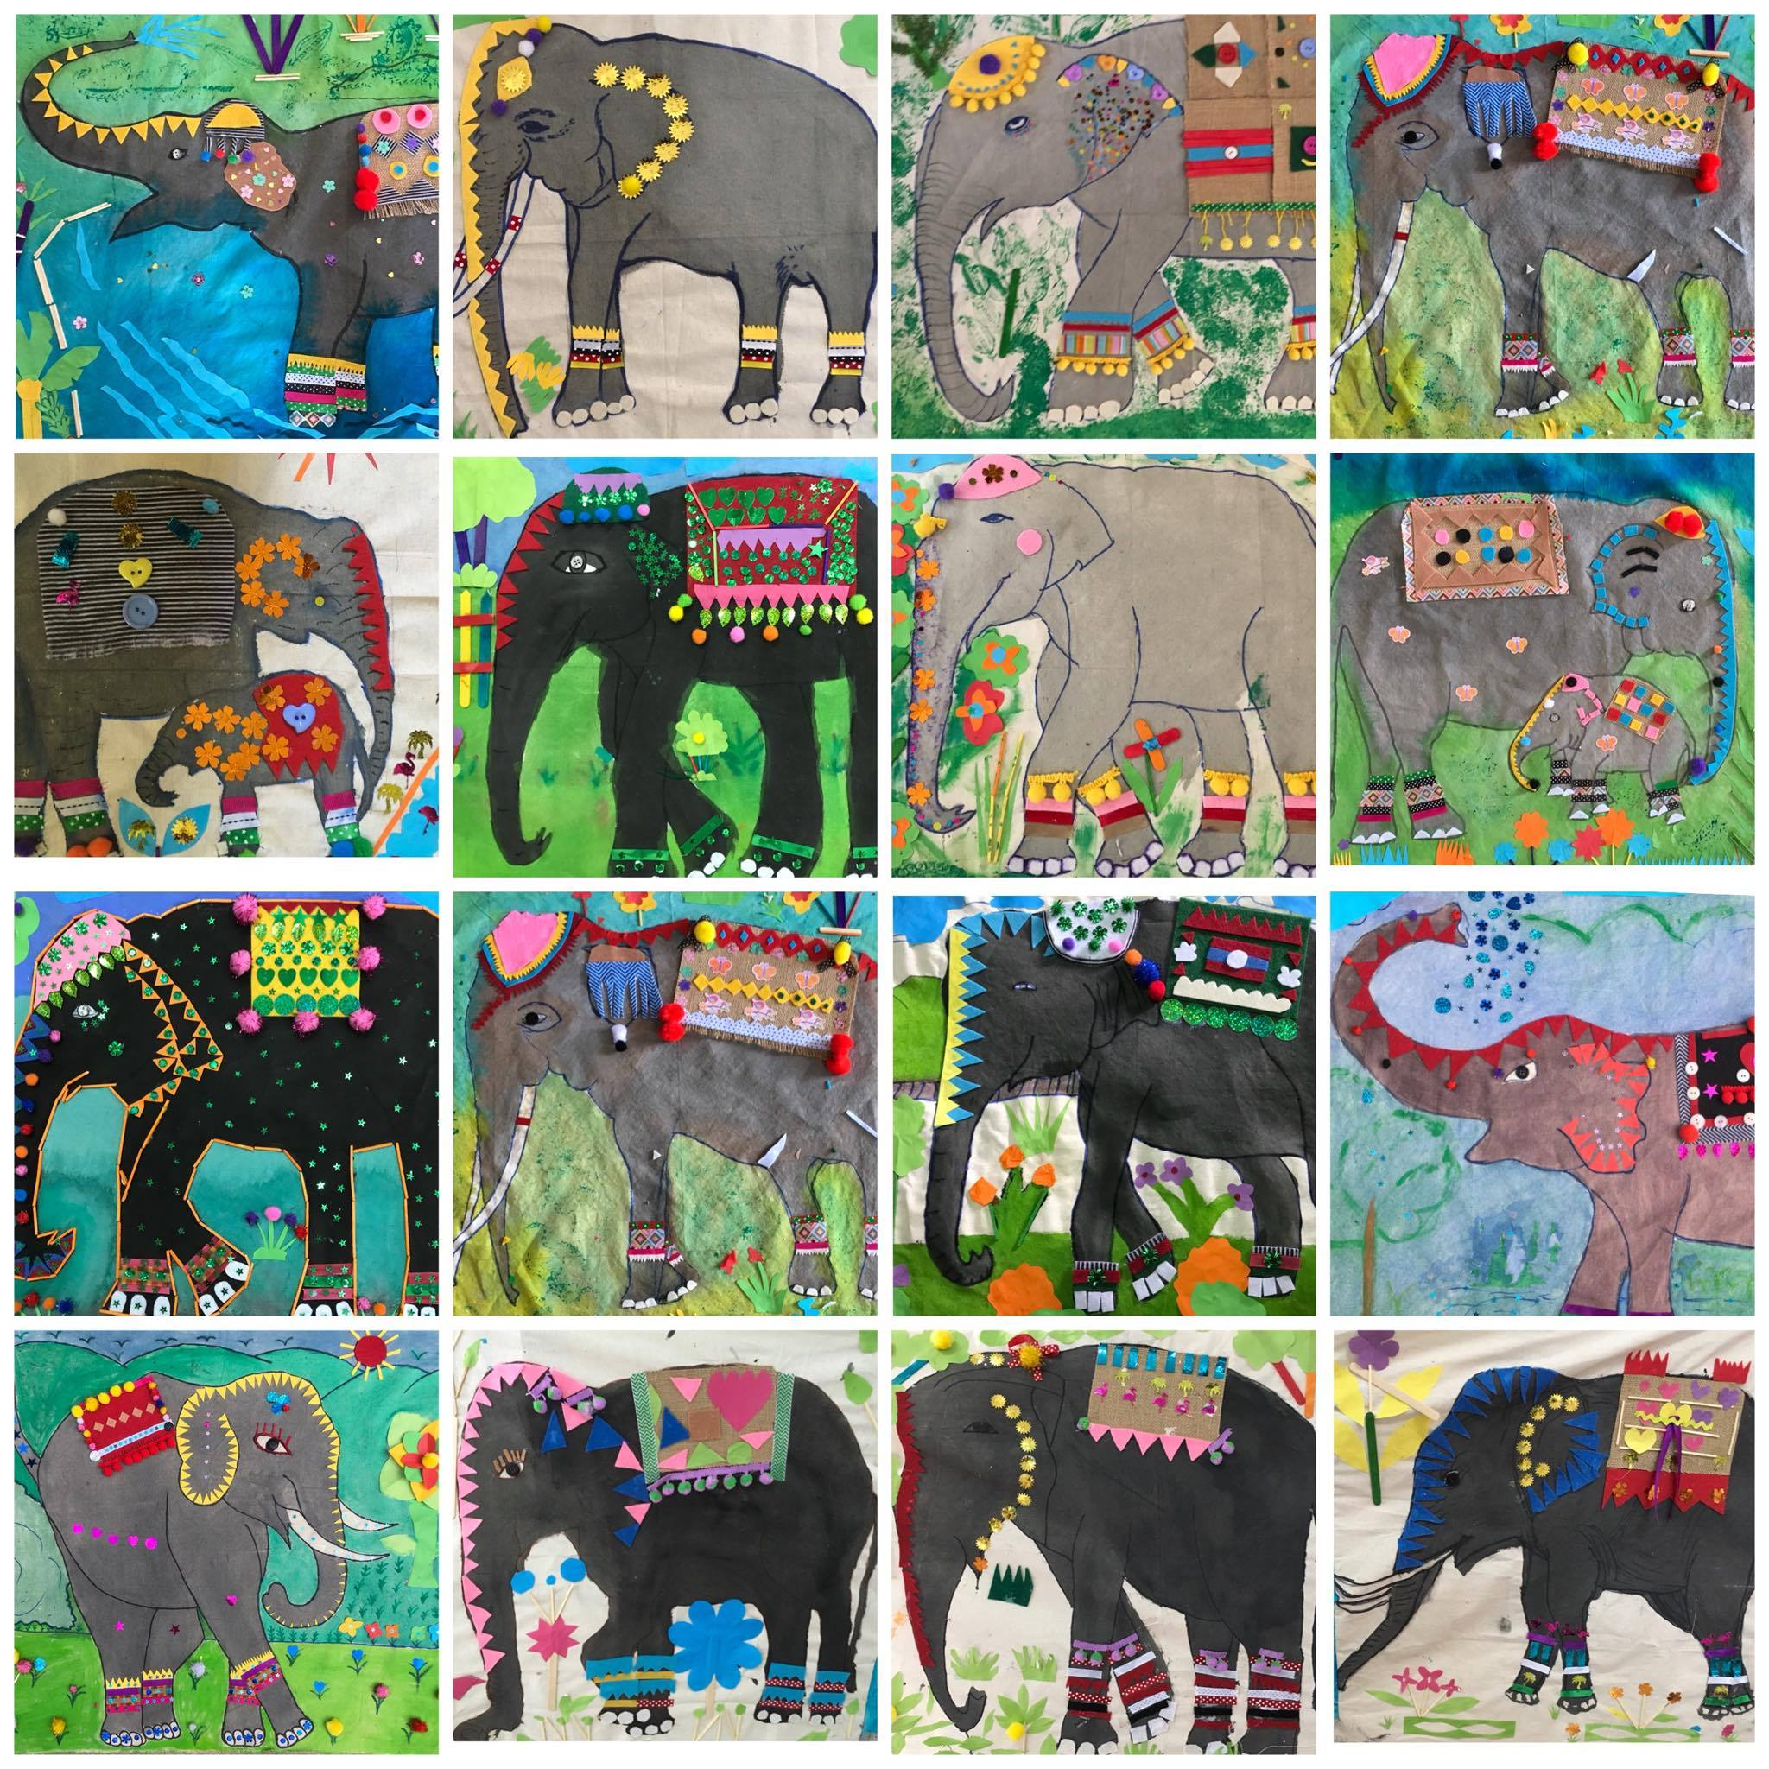
Inquiry in Laos
Focus on elephants

Slide 2
Question What is happening to the Asian elephants? Do you know?
Question
ຄໍາຖາມ
ມີຫຍັງເກີດຂຶ້ນກັບຊ້າງອາຊີ? ເຈົ້າ​ຮູ້​ບໍ່?
(Where have all the Laos elephants gone? Why is Laos no longer the Land of a Million Elephants?)

Slide 3
The students will learn all the aspects of the elephant including
Learning Intention
Learning
ນັກຮຽນຈະຮຽນຮູ້ທຸກດ້ານຂອງຊ້າງລວມທັງ
ລັກສະນະທາງກາຍະພາບຂອງຊ້າງມີຂະ ໜາດ, ສີແລະປາຍສຸດ (ຫູ, ລໍາຕົ້ນ, ຕີນແລະຕາ)
Elephant physical characteristics of size, colour and extremities (ears, trunk, feet and eyes)
Elephant nutrition and diet and reproduction
Adaptations that the elephants display to survive in the jungle conditions
ການໃຫ້ອາຫານແລະການສືບພັນຂອງຊ້າງ
ການປັບຕົວທີ່ຊ້າງສະແດງເພື່ອຄວາມຢູ່ລອດໃນສະພາບປ່າ

Slide 4
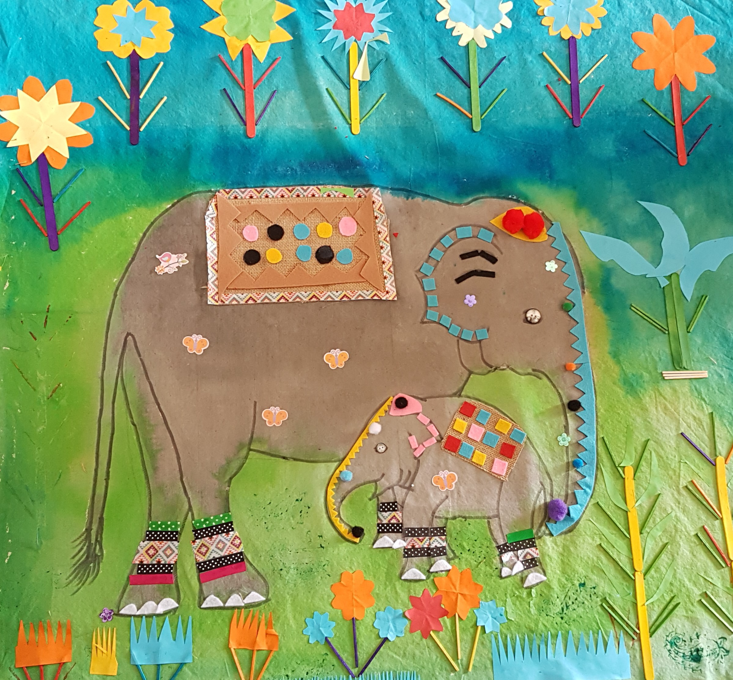
Learning Product
Learning Product
The students will learn about elephants to hand drawn and create an accurate scientific drawing of an elephant to display in the classroom.
ນັກຮຽນຈະໄດ້ຮຽນຮູ້ກ່ຽວກັບຊ້າງເພື່ອແຕ້ມດ້ວຍມືແລະສ້າງຮູບແຕ້ມທາງວິທະຍາສາດທີ່ຖືກຕ້ອງເພື່ອສະແດງຢູ່ໃນຫ້ອງຮຽນ.

Slide 5
Curriculum links- Australia
Curriculum
Living things have structural features and adaptations that help them to survive in their environment (ACSSU043) Questioning and predicting. With guidance, pose clarifying questions and make predictions about scientific investigations (ACSIS231)
Planning and conducting. Identify, plan and apply the elements of scientific investigations to answer questions and solve problems using equipment and materials safely and identifying potential risks (ACSIS086)
Processing and analysing data and information. Construct and use a range of representations, including tables and graphs, to represent and describe observations, patterns or relationships in data using digital technologies as appropriate (ACSIS090)
Compare data with predictions and use as evidence in developing explanations (ACSIS218) Evaluating. Reflect on and suggest improvements to scientific investigations(ACSIS091)
Communicate ideas, explanations and processes using scientific representations in a variety of ways, including multi-modal texts (ACSIS093)

Slide 6
Curriculum links- Laos
Curriculum

Slide 7
Materials per group
Materials
ຮຽບຮ້ອຍຂອງຜ້າ ເສົາໄມ້ໄຜ່ໃຫຍ່ເພື່ອໃສ່ຊ້າງຜ້າໃສ່ ເຈ້ຍຂະ ໜາດ 5 x A3 ສໍ ດຳ 10 ອັນ 10 ຮູບຂອງຊ້າງ ວັດສະດຸ - ຜ້າຜ້າສີຫຼາກຫຼາຍຊະນິດ
square of fabric as the base –
large bamboo pole to mount the fabric elephant on
5 x A3 sheets paper
10 x pencils (HB)
10 laminated pictures of elephants
Material – a range of coloured fabrics for the background (blue for water, greens for the grass, trees, grey and brown for the body of the elephant)

Slide 8
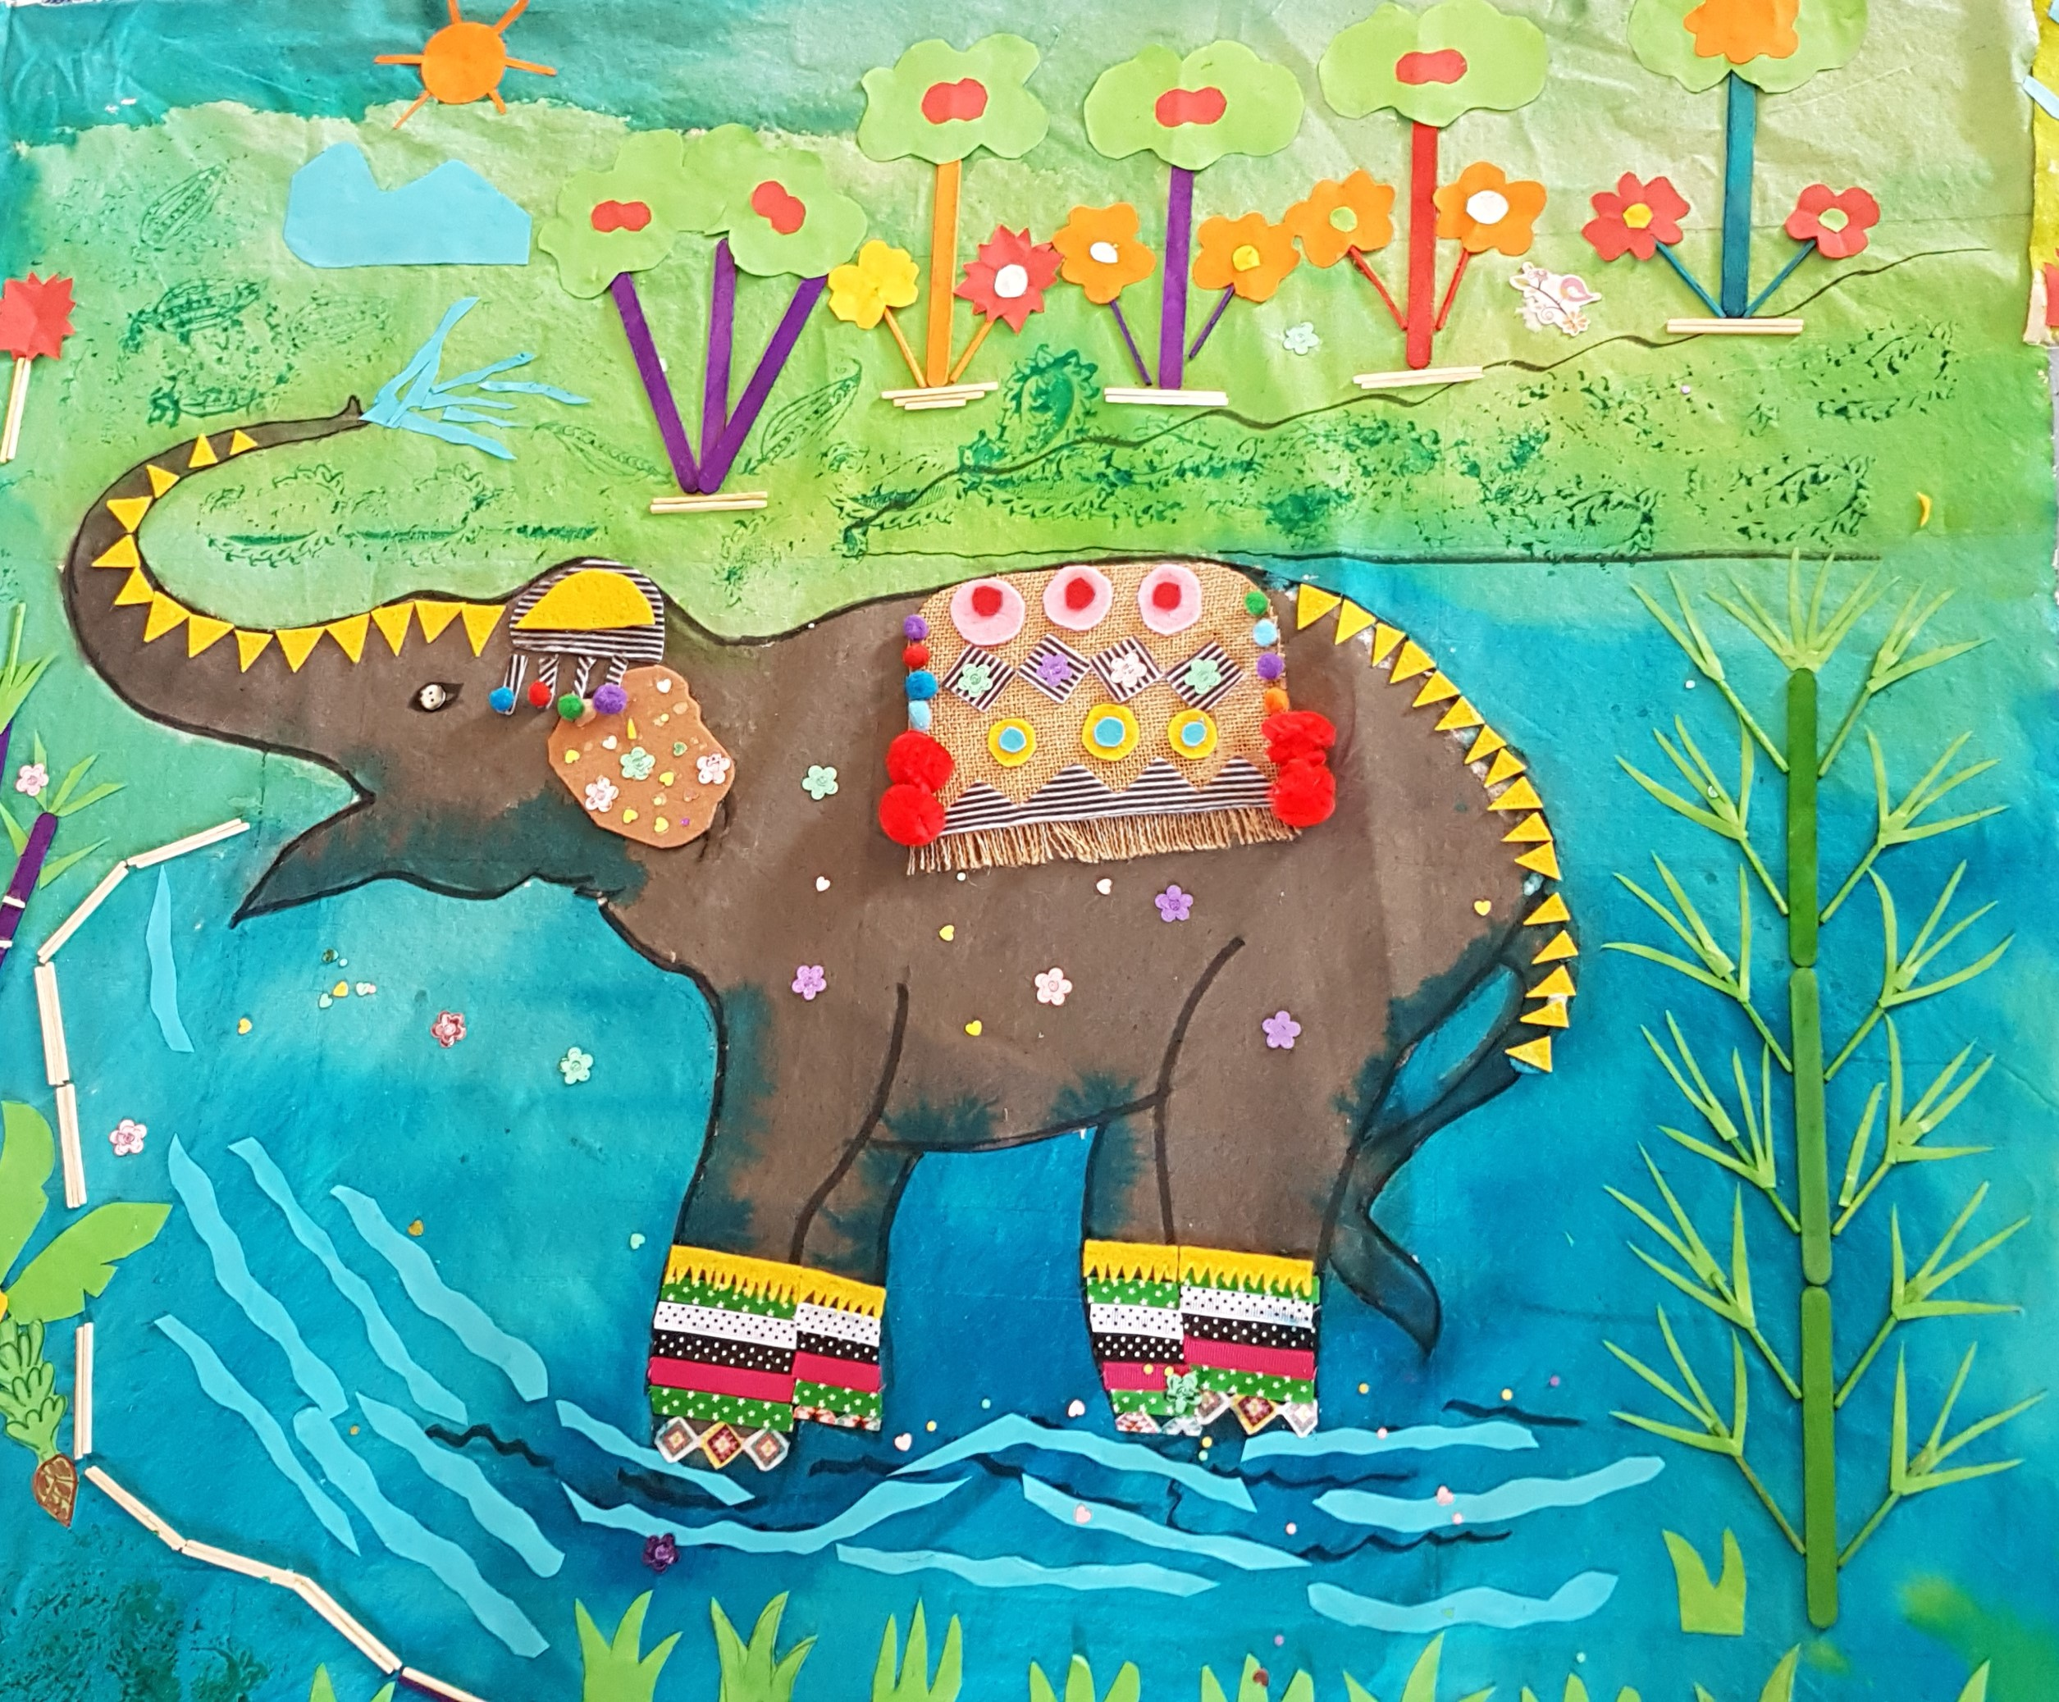
1. Tuning in
2. Finding out
3. Sorting out
4. Going Further
5. Celebrating
What do we know about
Elephants?
Would do we need to know?
Now we will find out these aspects of elephants
Now we have found out these aspects about elephants
What more can we find out?
Here is what we now know.
Asian elephants
Science
Asian elephants
Physical features
Habitat
Life cycle
Looking
Art
Creating an elephant table
Q. What is happening to the Asian elephants? Do you know?
ມີຫຍັງເກີດຂຶ້ນກັບຊ້າງອາຊີ? ເຈົ້າ​ຮູ້​ບໍ່?
Q. How can you look after elephants in Laos?
ເຈົ້າຈະເບິ່ງແຍງຊ້າງຢູ່ລາວໄດ້ແນວໃດ?

Slide 9
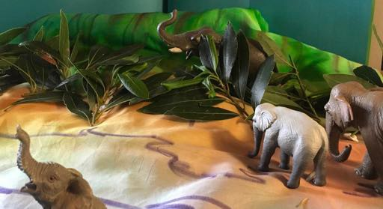
Tuning In
ຈູນເຂົ້າ
Purpose.
How.
Science
Art

Slide 10
Finding Out ຊອກຫາ
Purpose.
How.
Science
Art

Slide 11
Sorting Out
ການຈັດລຽງ
Purpose.
How.
Science
Art

Slide 12
Going Further ໄປຕື່ມອີກ
Purpose.
How.
Science
Art

Slide 13
Celebrating
ສະເຫຼີມສະຫຼອງ
Purpose.
How.
Science
Art

Slide 14
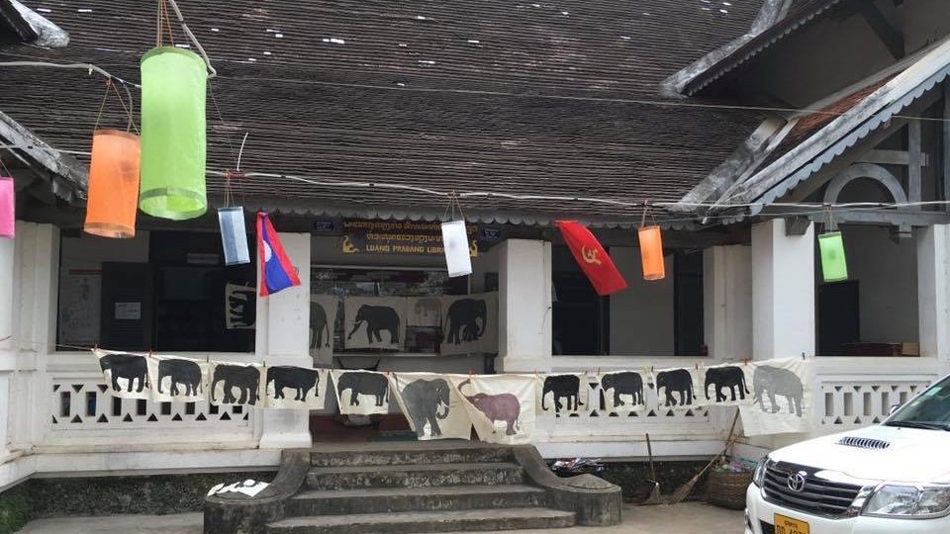
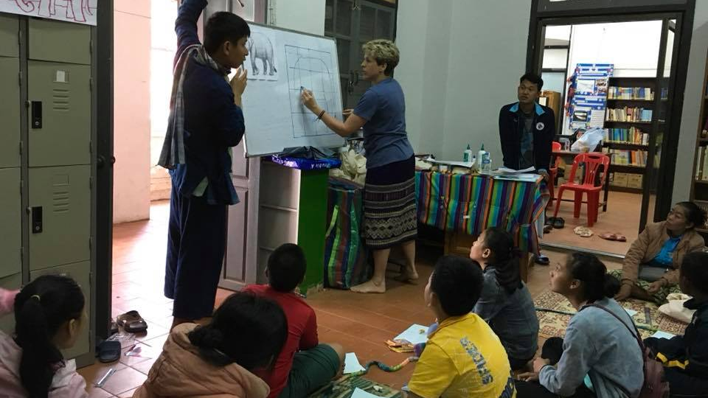
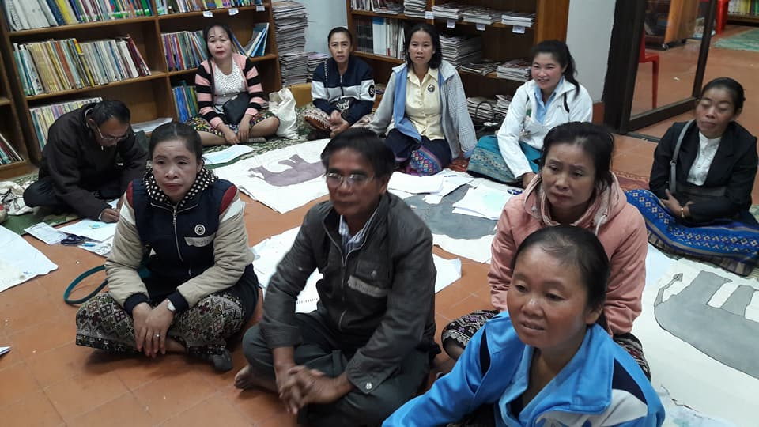
Inquiry on Elephants

